Slide 1
Securing Funding
SE495: Software Entrepreneurship

Slide 2
Outline
Overview
Crafting a Compelling Pitch
Investor Perspectives and Expectations
Due Diligence and Valuation
Incubators and Accelerators

Slide 3
Overview

Slide 4
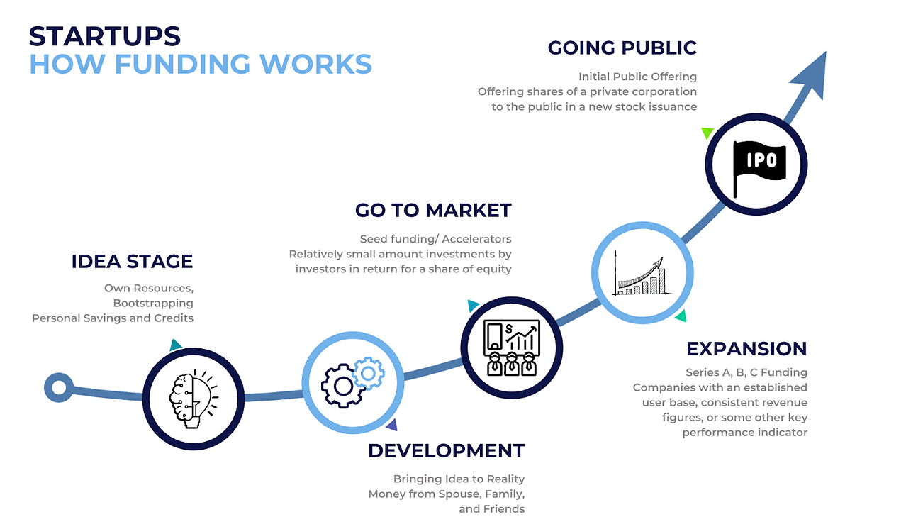

Slide 5
Why?
Software startups need funding to turn their ideas into reality
Funding can help startups hire talent, develop products, and scale operations
Different types of funding options available, each with pros and cons

Slide 6

Introduction to Pitching and Securing Funding
Pitching is the process of presenting a business idea or plan to potential investors or stakeholders to secure funding.
Pitching is crucial for securing funding, as it allows entrepreneurs to showcase their idea, team, and vision to investors, and convince them to invest in their business.

Slide 7

Types of Pitches
Elevator pitch
A brief, 30-second to 1-minute pitch that highlights the key aspects of a business idea, often used in informal settings.
Pitch deck
A visual presentation that summarizes a business idea or plan, typically consisting of 10-20 slides, used in formal pitching sessions.
Other types of pitches:
Executive summary
Business plan

Slide 8

Standing Out from the Crowd
With many startups vying for funding, a compelling pitch is crucial for standing out from the crowd and securing investor interest.
Key elements of a compelling pitch:
Unique value proposition
Strong team
Large market opportunity
Competitive advantage
Clear business model

Slide 9
Research, Practice, and Perfect Your Pitch
Research
Understand the investor's interests, preferences, and criteria for investment.
Practice
Rehearse the pitch to ensure a smooth and confident delivery.
Perfect
Refine the pitch based on feedback from mentors, advisors, and potential investors.

Slide 10
Confidence, Passion, and Storytelling
Confidence
Show confidence in the business idea and team.
Passion
Demonstrate passion for the business and its potential impact.
Storytelling
Use storytelling techniques to engage the audience and make the pitch memorable.

Slide 11
Crafting a Compelling Pitch

Slide 12
Crafting a Compelling Pitch
A pitch is a presentation that entrepreneurs use to convince investors or stakeholders to invest in their business.
A compelling pitch is crucial for securing funding and support for a business.
Problem statement
Solution
Market opportunity
Competitive advantage
Business model
Team

Slide 13
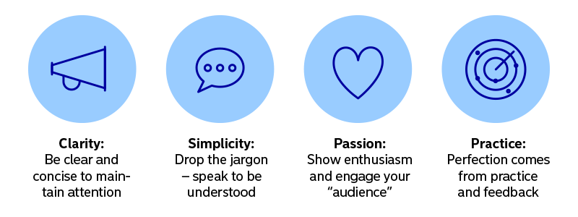
Tips for Creating a Clear and Concise Pitch
Focus on the essentials
Avoid unnecessary details and focus on the key elements of the pitch.
Practice
Rehearse the pitch to ensure a smooth and confident delivery.
Use storytelling techniques
Use anecdotes and examples to make the pitch more engaging and memorable.

Slide 14
Common Mistakes to Avoid in a Pitch
Lack of preparation: Failing to research the investor's interests and preferences.
Poor storytelling: Failing to engage the audience with a compelling narrative.
Overemphasis on technology: Focusing too much on the technical details of the product or service.

Slide 15
Crafting a Compelling Pitch
Understanding Your Audience
Defining Your Value Proposition
Crafting a Captivating Story
Building a Strong Brand
Creating a Compelling Demo
Preparing for Common Questions
Practicing Your Pitch
Delivering a Confident and Effective Pitch

Slide 16
Final tips
Be authentic and passionate about the business.
Use visual aids to support the pitch.
Anticipate questions and have a clear call to action.

Slide 17
Investor Perspectives and Expectations

Slide 18

Introduction
Investors are individuals or organizations that provide capital to startups in exchange for equity or other forms of return.
Understanding investor perspectives is crucial for crafting a compelling pitch and securing funding.

Slide 19
Types of Investors and Their Expectations
Friends/Family
Friends and family investors are typically motivated by a personal relationship with the entrepreneur and have a lower risk tolerance.
They expect a lower return on investment and are more focused on supporting the entrepreneur.

Slide 20

Types of Investors and Their Expectations
Angels:
Angel investors are typically high net worth individuals who invest their own personal capital in startups in exchange for equity.
They have a higher risk tolerance than friends/family investors and expect a higher return on investment.

Slide 21
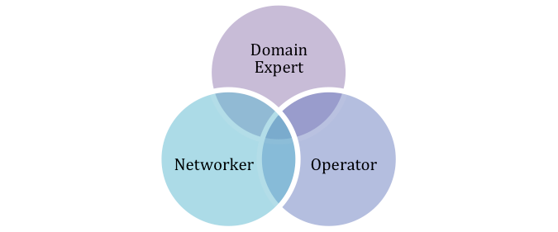
Types of Investors and Their Expectations
VCs
Venture capitalists (VCs) invest capital in startups in exchange for equity and take an active role in the company's growth.
They have a high risk tolerance and expect a significant return on investment.

Slide 22

Importance of Understanding Investor Perspectives
Understanding investor perspectives helps entrepreneurs tailor their pitch to the specific investor.
A well-crafted pitch that addresses investor concerns can increase the chances of securing funding.

Slide 23
Meets Investor Expectations
Focus on the problem the startup is solving and the solution it offers.
Highlight the market opportunity and the startup's competitive advantage.
Emphasize the team's relevant skills and experience.

Slide 24
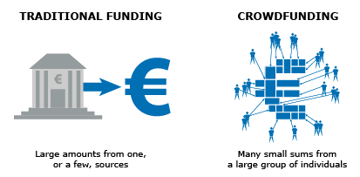
Crowdfunding
A method of raising capital through small contributions from a large number of people, typically through an online platform.
Crowdfunding can provide valuable marketing and exposure for a startup, and it can help entrepreneurs validate their idea and build a community of supporters.
Crowdfunding may not provide enough capital to meet a startup's needs, and it can be time-consuming and resource-intensive.

Slide 25
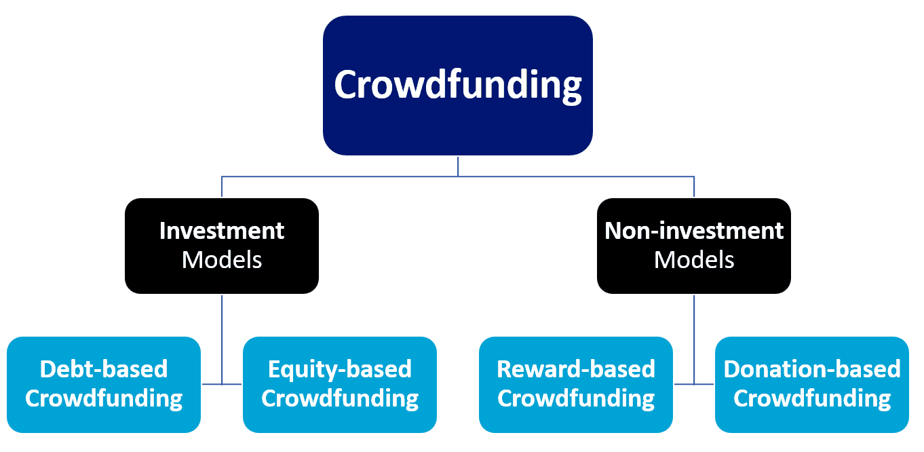
Crowdfunding

Slide 26
Final tips
Research the investor's interests and preferences before crafting a pitch.
Use storytelling techniques to engage the investor and make the pitch more memorable.
Anticipate questions and have a clear call to action.

Slide 27
Due Diligence and Valuation

Slide 28
Due Diligence Process
Due diligence is the process of conducting a thorough examination of a business or investment opportunity to confirm all facts and assess its potential for growth.
Due diligence is crucial for investors to make informed decisions and for entrepreneurs to secure funding.

Slide 29
Key Items to Include in a Due Diligence Package
Business plan
A comprehensive plan outlining the business model, market opportunity, competitive landscape, and growth strategy.
Financial projections
Detailed financial statements, including income statements, balance sheets, and cash flow statements.
Market research
Analysis of the target market, including size, growth potential, and trends.
Legal documents
Copies of all relevant legal documents, such as contracts, patents, and trademarks.

Slide 30
Overview of Valuations and Term Sheets
Valuation
The process of determining the economic value of a business or asset.
Term sheet
A non-binding agreement outlining the basic terms and conditions of a proposed investment.

Slide 31
Importance of Understanding Terms and Conditions
Understanding the terms and conditions of funding agreements is crucial for entrepreneurs to avoid misunderstandings and ensure they receive the funding they need.
Key terms to focus on include valuation, equity ownership, board representation, and liquidation preferences.

Slide 32
Factors that Contributed to Success
Strong leadership
Innovative products or services
Market timing

Slide 33
Incubators and Accelerators

Slide 34
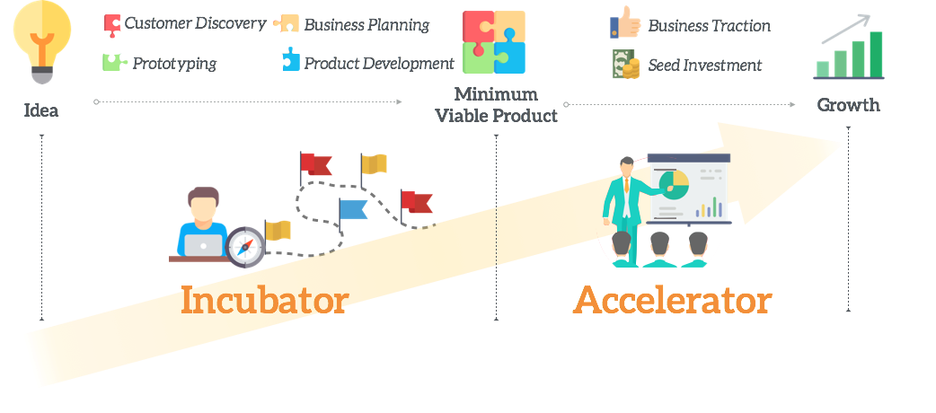
Incubators and Accelerators

Slide 35
Incubators and Accelerators
Incubators and accelerators are programs designed to support early-stage startups and help them grow and succeed.
Incubators focus on nurturing startups in their early stages, while accelerators provide a more structured program with a fixed duration and a focus on scaling.

Slide 36
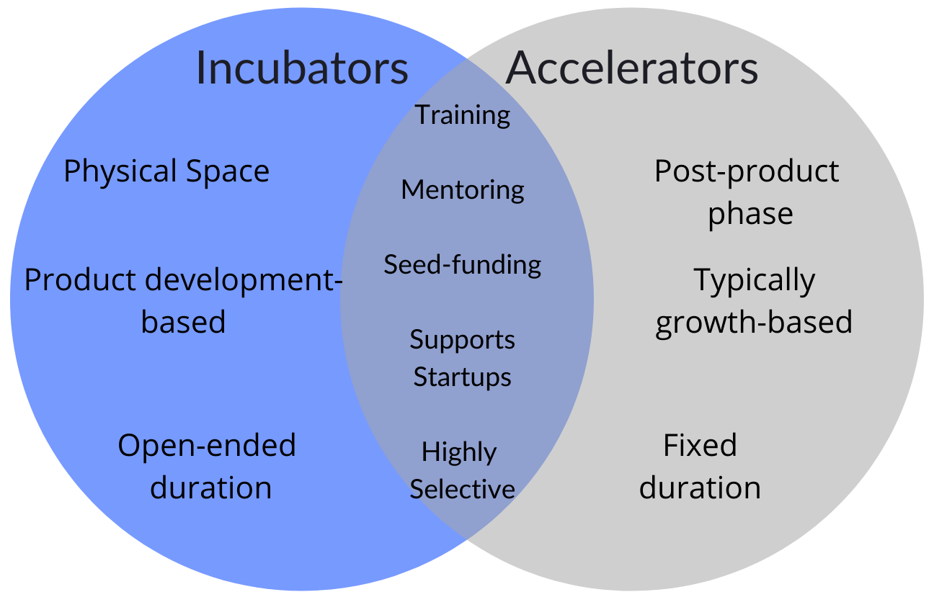
Incubators and Accelerators
Incubators focus on nurturing startups in their early stages
Accelerators provide a more structured program with a fixed duration and a focus on scaling.

Slide 37
Types of Incubators and Accelerators
Incubators:
University-based incubators
Independent incubators
Corporate incubators
Accelerators:
General accelerators
Sector-specific accelerators (e.g., fintech, healthtech)
Corporate accelerators

Slide 38
Benefits of Incubators and Accelerators
Access to resources
Incubators and accelerators provide startups with access to resources such as office space, mentorship, networking opportunities, and funding.
Guidance and support
Startups receive guidance and support from experienced entrepreneurs, investors, and industry experts.
Focus and accountability
Incubators and accelerators provide a structured environment that helps startups stay focused and accountable.

Slide 39
Incubator and Accelerator Programs
Typical programs offered by incubators:
Business planning and strategy
Marketing and branding
Legal and regulatory compliance
Access to funding and finance
Typical programs offered by accelerators:
Mentorship and coaching
Workshops and training sessions
Pitching and presentation skills
Access to funding and investors

Slide 40
Examples of Successful Incubators and Accelerators
Incubators:
Y Combinator (Airbnb, Dropbox, Reddit)
500 Startups (Twilio, SendGrid, Intercom)
Techstars (SendGrid, Sphero, Fitbit)
Accelerators:
Accel (Dropbox, Facebook, Spotify)
KPCB (Google, Twitter, Uber)
Greylock (Airbnb, Facebook, LinkedIn)

Slide 41
Saudi Incubators and Accelerators
9/10ths
KAUST Innovation Fund
Riyadh Valley Company
Business Incubators and Accelerators Company
Taqadam
Falak Business Hub
Nomow Incubator
SURE International Technology
Startups House
Wa'ed
Wadi Makkah

